Slide 1
Learnings from Activist-in-Residence (AiR) Schemes in Universities
UK Science Festivals Network Conference 2025
Dr Ed Stevens
Rebecca Pericleous

Slide 2
Icebreaker: Envisioning aCTIVISM
• Take 3 mins to draw what comes to mind when you think of activism! Who are the activists? Where are they? What are they doing?
• Share your drawing with a person near you.

Slide 3
Searching for an Activist

Slide 4
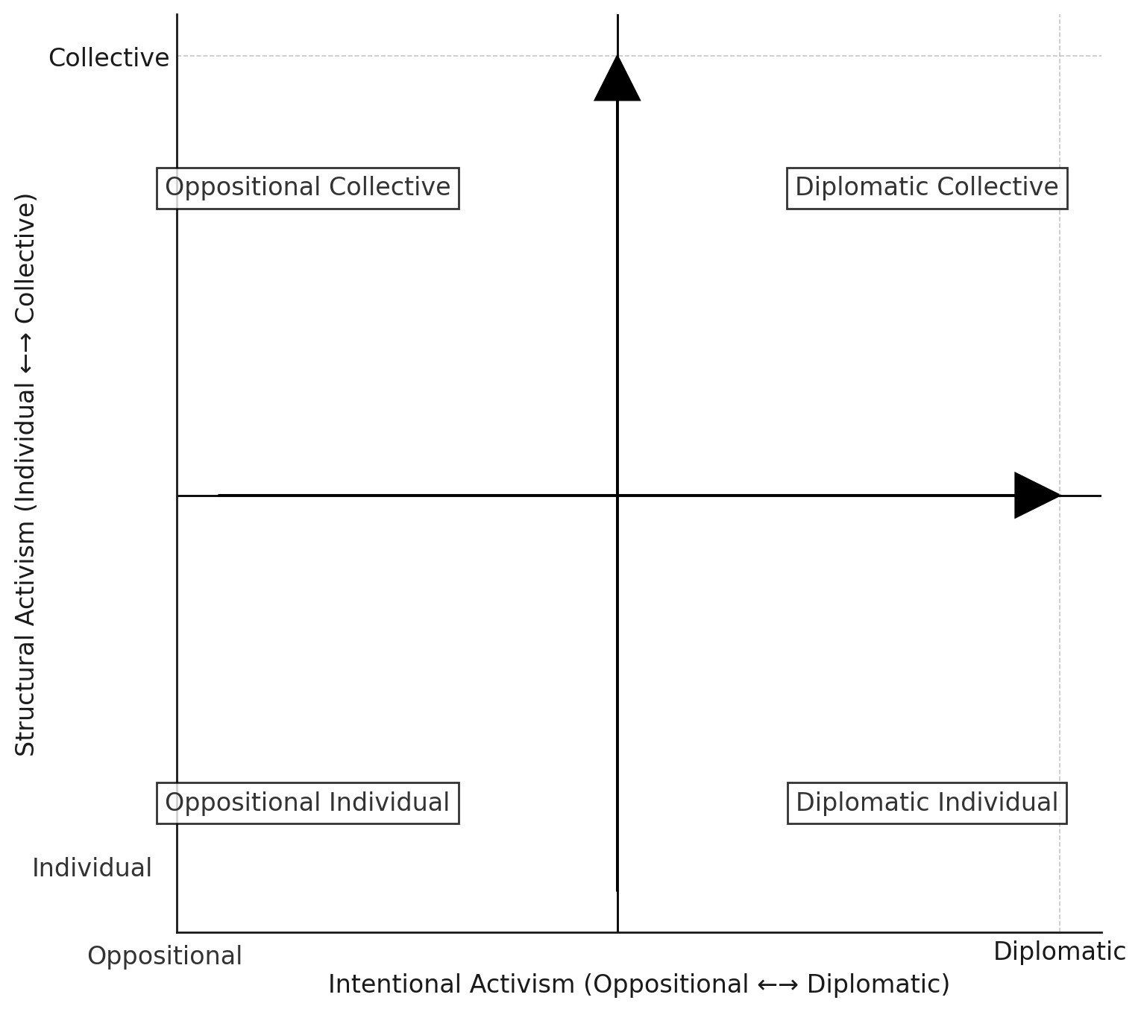
Some theory on activism in universities
• AiR schemes provide structured institutional spaces for activist-academic collaboration.
• Universities can both support and constrain activism.
• Festivals, like universities, operate within institutional structures.

Slide 5
Case Studies from King’s College London
• Rebel by Default worked with women living with HIV, focusing on their lived expertise and capacity to bring about change.
Dr Katharine Low (GKT School of Medical Education/Centre for Education), Dr Ella Parry-Davies (English/Centre for Humanities and Health) and Positively UK.

Slide 6
Case Studies from King’s College London
• Reimagining Language Justice through the Art of Translation examined language injustice and political domination.
Dr Sanja Perovic (Languages, Literatures and Cultures), Dr Rosa Mucignat (Languages, Literatures and Cultures) and Cristina Viti (professional translator).

Slide 7
Case Studies from King’s College London
• Moving/homing by kindredpacket centred on people with East and Southeast Asian backgrounds and intersections between home, movement and digital technologies.
Dr Wing-Fai Leung (Culture, Media & Creative Industries), Dr Jonathan Gray (Digital Humanities) and David Kam (movement artist and teacher).

Slide 8
Case Studies from King’s College London
• Race Across the Channel investigated the digressive strategies used by French and British elites to counter antiracist scholarship.
Dr Reza Zia-Ebrahimi (History), Rokhaya Diallo and Grace Ly (writers, journalists and activists)

Slide 9
Brainstorming: Bringing Activism to Festivals
Small Group Discussion
Divide into small groups.
Each group to answer a question (10 mins):
How might engaging with activists enhance the impact of festivals?
Why might activists wish to be involved in festivals?
What barriers might exist for festivals looking to engage with activists, and how might these barriers be overcome?
Each group to share key takeaways.

Slide 10
Reflection on Identity & Collaboration
The dual role of academics and activists— in AiR projects, we saw that academics and activists often blur and overlap roles. What does this mean for collaboration?
Many academics do activist work without calling themselves activists. How does this shape our perception of activism?
Observing a shift from ‘activists and academics’ to ‘activist-academics’.
Challenges of “activist” identity in academic spaces—how institutions both support and constrain activist work.
Personal Reflection: “How can we recognise activism within ourselves, even in structured institutions?” — challenging your professional identity

Slide 11
Closing & Q&A
Key Takeaways:
AiR schemes enable transformative collaboration but require careful navigation of power dynamics.
Like universities, festivals have institutional structures that can either support or limit activism.
Festivals, like universities, can integrate activist methodologies for greater social impact.
The lines between activist and academic work are not always rigid—we all have activist potential.
• What steps can you take to incorporate activist methodologies into your own work?

Slide 12
Relevant LINKS
Stevens, E., Dhavan, N., & Matzner, S. (2024). Activism and the academy: Implementing and evaluating activist-in-residence programmes. Research for All, 8(1). https://doi.org/10.14324/RFA.08.1.09: https://journals.uclpress.co.uk/r4a/article/id/3349/
Researchers propose new evaluation framework for activist-in-residence models | King's College London
Faculty of Arts & Humanities launches innovative Activist-in-Residence Scheme | King's College London
ParaPride: Activist-in-residence scheme | King's College London

